Slide 1
Ethereum Fraud Detection
Letian YU (FTEC)
The Chinese University of Hong Kong
Letian YU

Slide 2
TABLE OF CONTENTS
01
02
03
PROBLEM & Data Description
Feature Engineering
Model Result & Future Improvement
- Objective
- Dataset
- Feature Engineering
- Data Analysis
- XGBoost Result
- Improvement

Slide 3
01
PROBLEM & Dataset

Slide 4
Objective & Dataset
Goal:
Detect fraudulent Ethereum address
Dataset:
train_accounts.csv
test_accounts.csv
transactions.csv

Slide 5
Data Description
Train Accounts:
Test Accounts:
Transactions:
Fraud | Non-fraud | Total
2455 | 22743 | 25198
Total | 6300
Total Records | Unique Sender Account | Unique Receiver Account
5826604 | 604847 | 419535
Notes:
We can find that the number of accounts in the transaction dataset is much more than the sum of training and testing accounts.
Not all of the accounts are covered in the training and testing accounts. There is no missing values in our dataset.

Slide 6
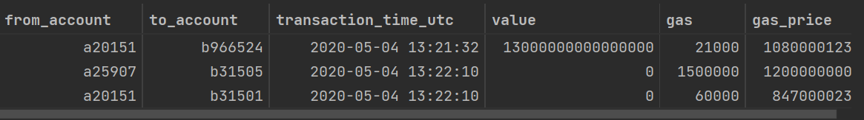
Transaction Data
Feature Datatype:
# Column Dtype
--- ----------- --------
0 from_account object
1 to_account object
2 transaction_time_utc object
3 value object
4 gas int64
5 gas_price int64
Sample:
Dataset Preprocessing:
Convert transaction time to date, year, year_month
Convert value (large number) to the magnitude of digit, add flag to indicate whether the transaction is token or not
Convert unit of gas price from GWEI to ETH (to reduce the scale of data)
Calculate gas fee based on gas and gas price
Notes:
We can find that the number of accounts in the transaction dataset is much more than the sum of training and testing accounts.
Not all of the accounts are covered in the training and testing accounts.

Slide 7
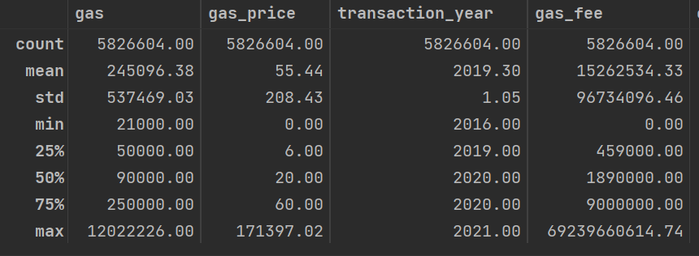
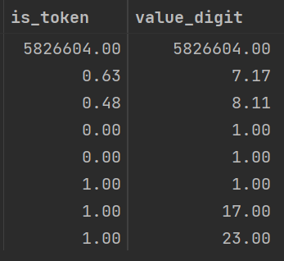
Transaction Data
Notes:
We can find that the number of accounts in the transaction dataset is much more than the sum of training and testing accounts.
Not all of the accounts are covered in the training and testing accounts.

Slide 8
02
Feature Engineering

Slide 9
KEY IDEA:
Construct feature for each account in the train-test list

Slide 10
SOLUTIONS Construct features for accounts in the list (as sender & as receiver)
Gas
General Info
Value
Transaction Count
Max, min, mean, std for gas price, gas fee, and gas
# of transactions,
# of year coverage,
Sender/receiver fraud or not
# of token transactions,
Max, min, mean, std for value scale
Max, mean, std of transaction count by year, month, date
Notes:
1. from account features 2. to account features

Slide 11
Feature Engineering
General Info Value Gas Transaction
Constructed features: 57
Further processing:
Fill null-values
Log-transformation for skewed distribution with long tail
(7)
(8)
(24)
(18)

Slide 12
Explorary Data Analysis (Sample)

Slide 13
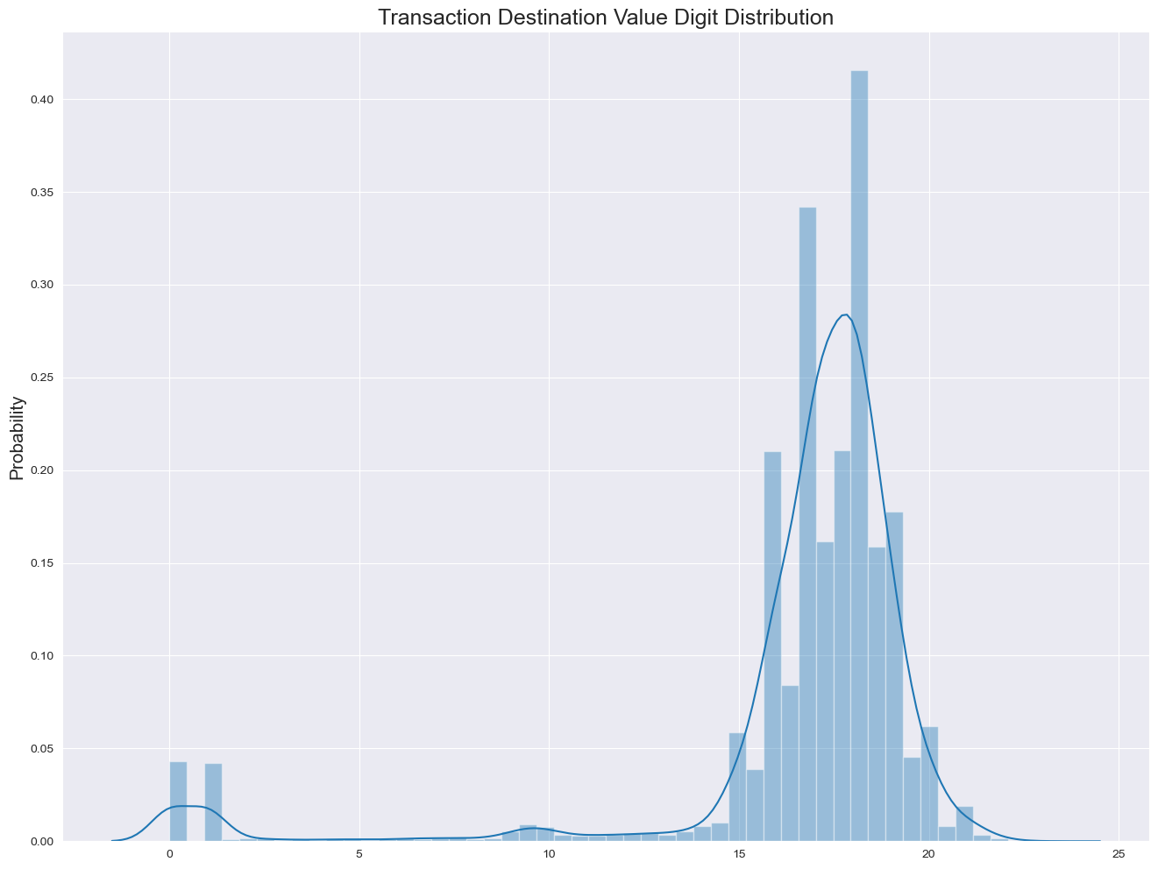
Receiver Value Log Sacle Distribution

Slide 14
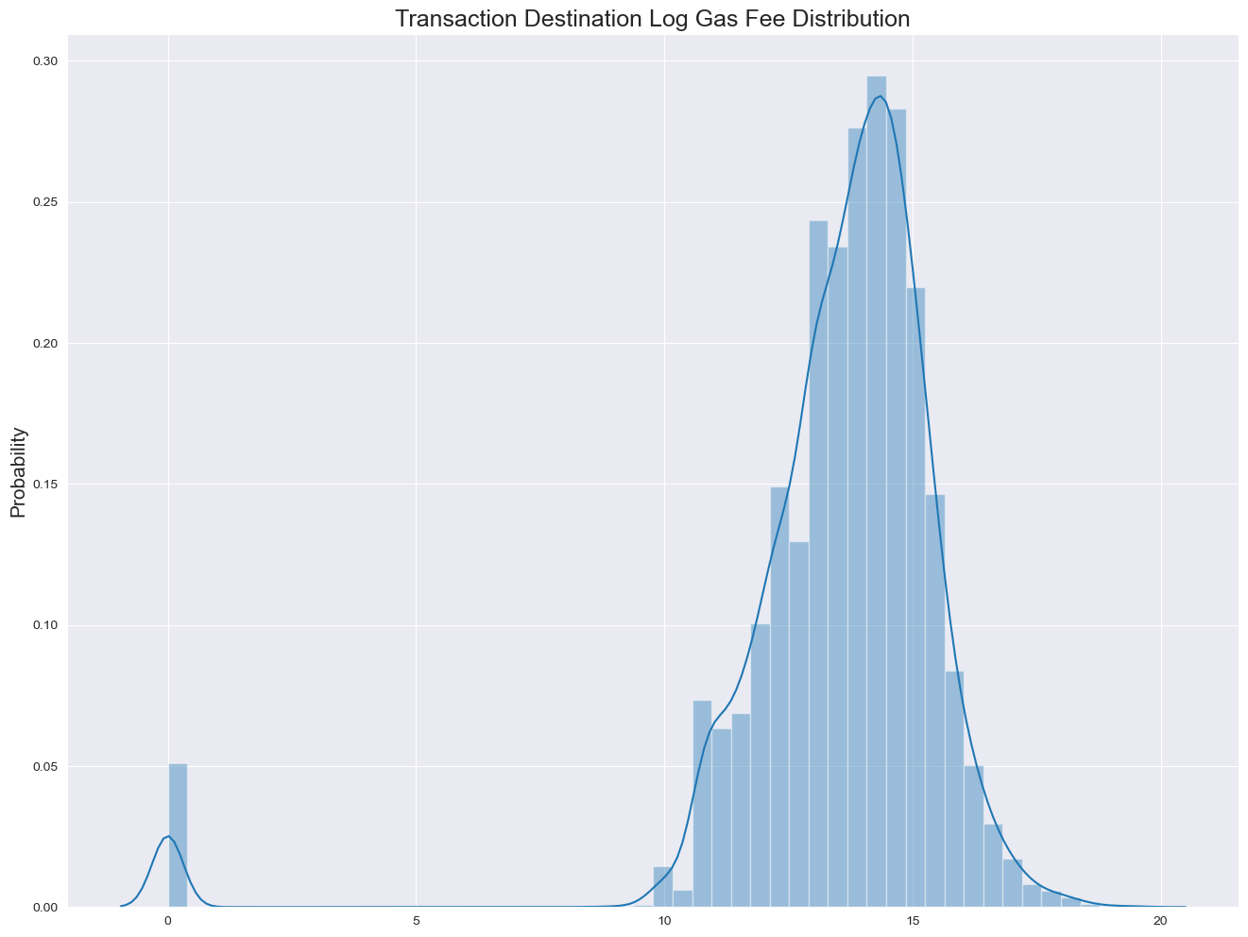
Receiver Log Gas Fee Mean Distribution

Slide 15
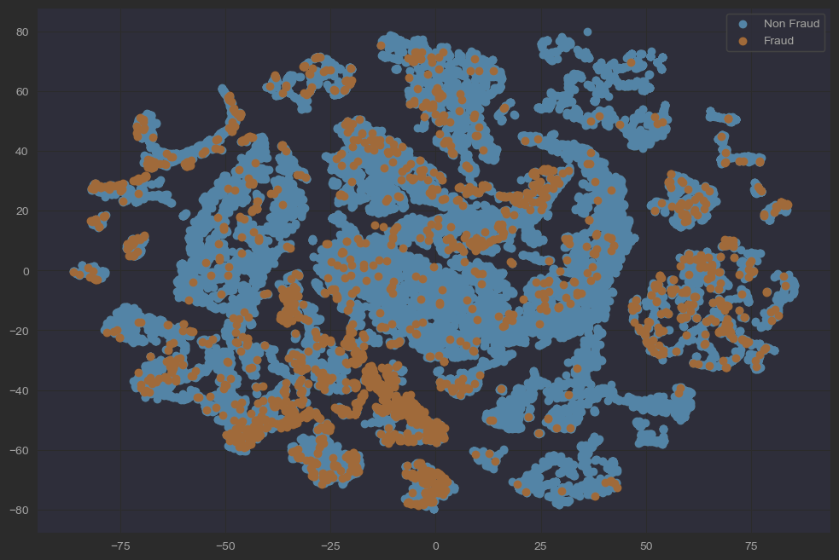
Sampled T-SNE Visualization (2D)

Slide 16
03
Model Result

Slide 17

Model: XGBoost
Grid-search for parameter tuning
Stratified-kfold cross validation to avoid overfitting
Evaluation Metrics: f1-score (Best: 0.7531 on training data)
Tuned parameters: learning rate, n estimators, max depth, subsample, gamma

Slide 18
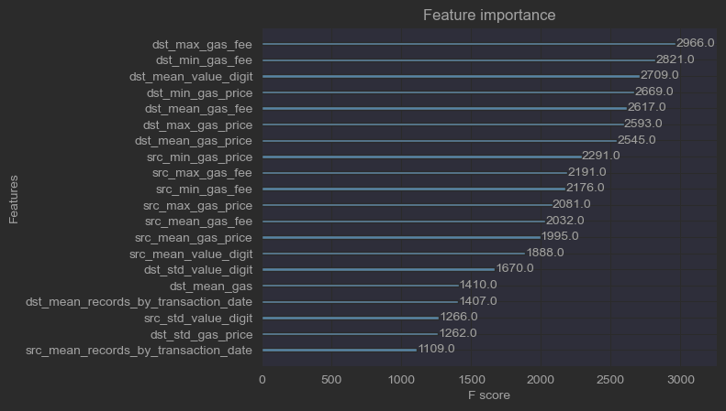
Feature Importance (by f-score)

Slide 19
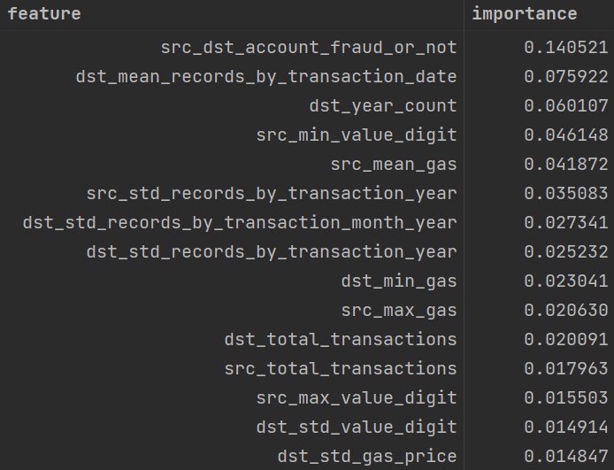
Feature Importance (built-in function)

Slide 20
Model Comparison: Logistic Regression
 | CV | Tuning | F1-score
XGBoost | Yes | Yes | Around 0.75 on training set
Logistic Regression | Yes | Only iter_num | Aroud 0.59 on training set

Slide 21
Future Improvement
Features:
More features using transaction time data
Construct features with more information (e.g., # of token to pct of token)
Dataset:
Data scale not balanced
Need to carefully check data quality and feature meaning
Model:
Try deep learning model as alternative comparison
Task:
Change to classification task on transaction record (need to design the metrics more carefully)

Slide 22
THANKS!

Slide 23
Appendix
Feature Correlation

Slide 24
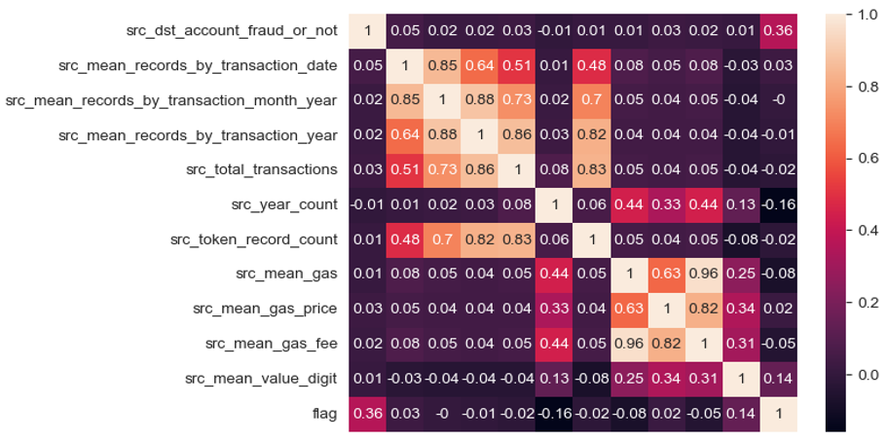
Correlation Analysis (Pearson coefficient)

Slide 25
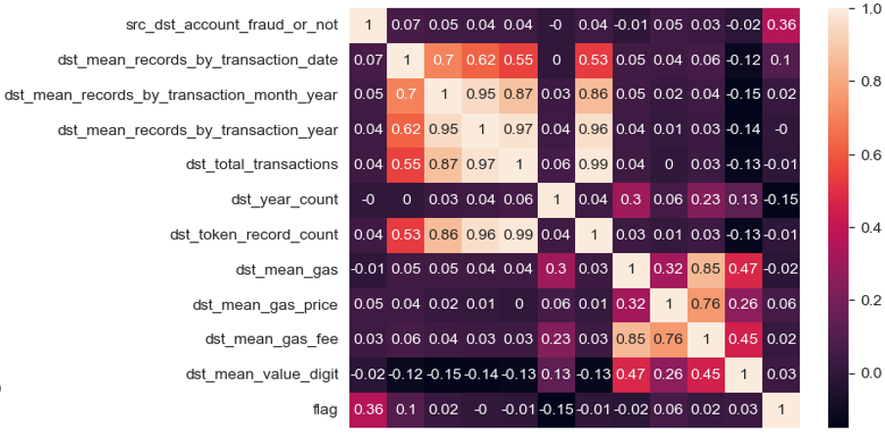
Correlation Analysis (Pearson coefficient)

